Slide 1


Internet of Things
for
Healthy Plants
Notes:
Use google chrome!! Cantonese!

Slide 2
Link to this PowerPoint:
https://tinyurl.com/y26yp6qn

Slide 3
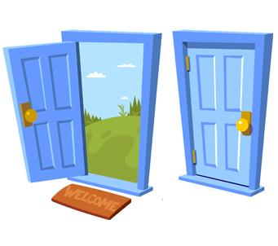




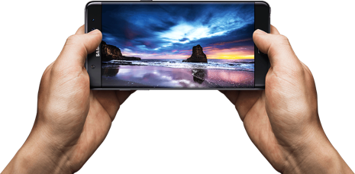
Internet of Things (IOT)
The ability connect objects/devices using the internet!

Slide 4



IOT for Healthy Plants
What kind of energy and resources help plants grow healthy and strong?

Slide 5
Grove
Arduino kit to help us with this project!
Has a variety of sensors to help us with the building process.

Slide 6
Our kit!

Slide 7
A2 : Moisture Sensor
D4: Temperature Sensor
I2C: LCD Screen
A1: Light Sensor

Slide 8
https://tinyurl.com/y6g7t3za

Slide 9
Ideal Growing Conditions
50-60 F, can live between 32-80 F
Ideal soil pH: 6.5
Ideal light: 4-6 hours of sunlight per day
Water: Moist soil

Slide 10
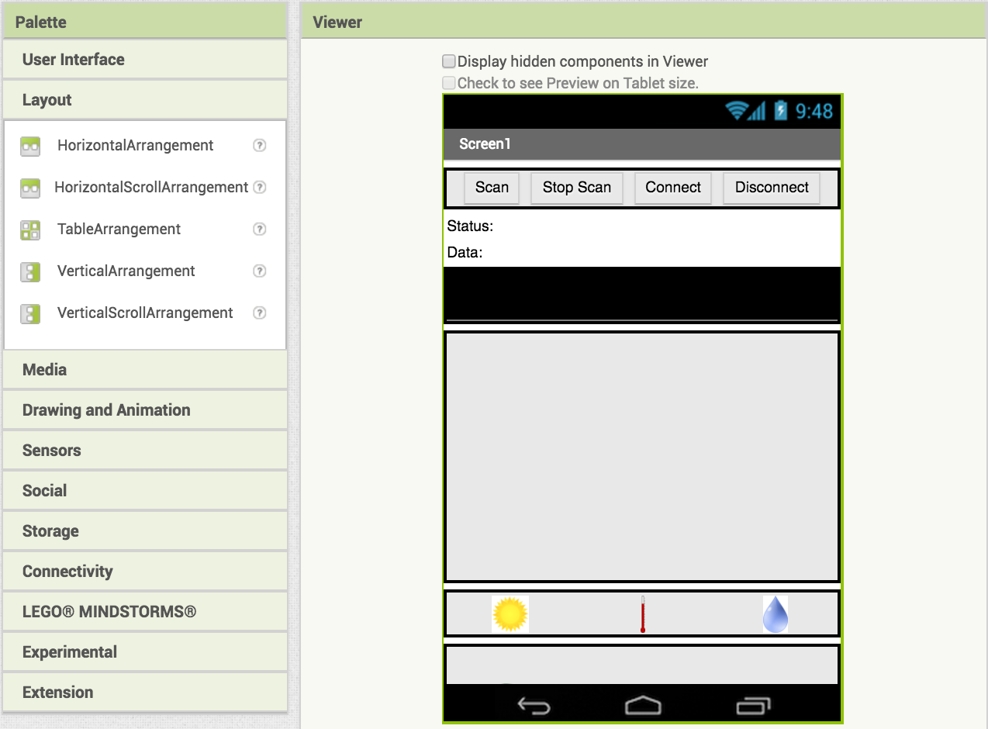
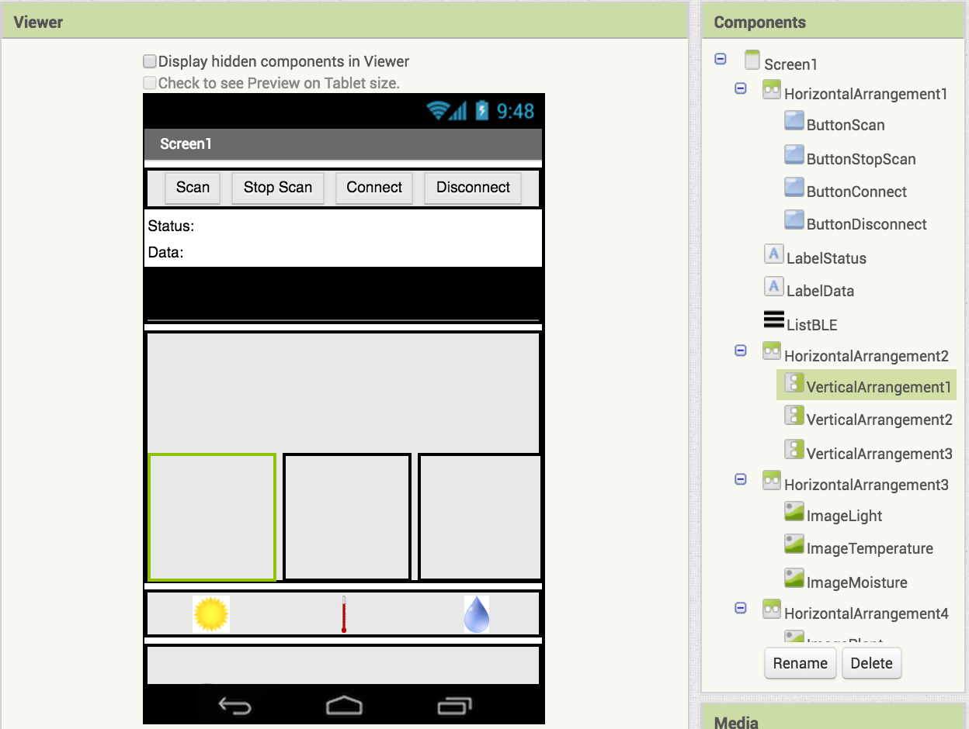
Adding Graphs
Add 3 VerticalArrangements inside the HorizontalArrangement
3x
Your screen should now look like this:

Slide 11
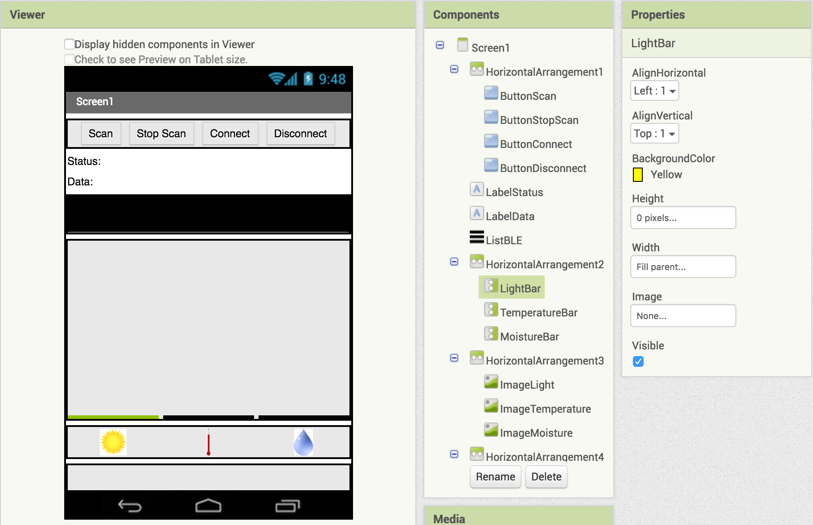
Rename them LightBar, TemperatureBar, MoistureBar

Slide 12

Set each bar's height to 0px and width to Fill Parent
Now set LightBar BackgroundColor to Yellow, TemperatureBar BackgroundColor to Red, and MoistureBar BackgroundColor to Blue
The boxes should now look flat

Slide 13

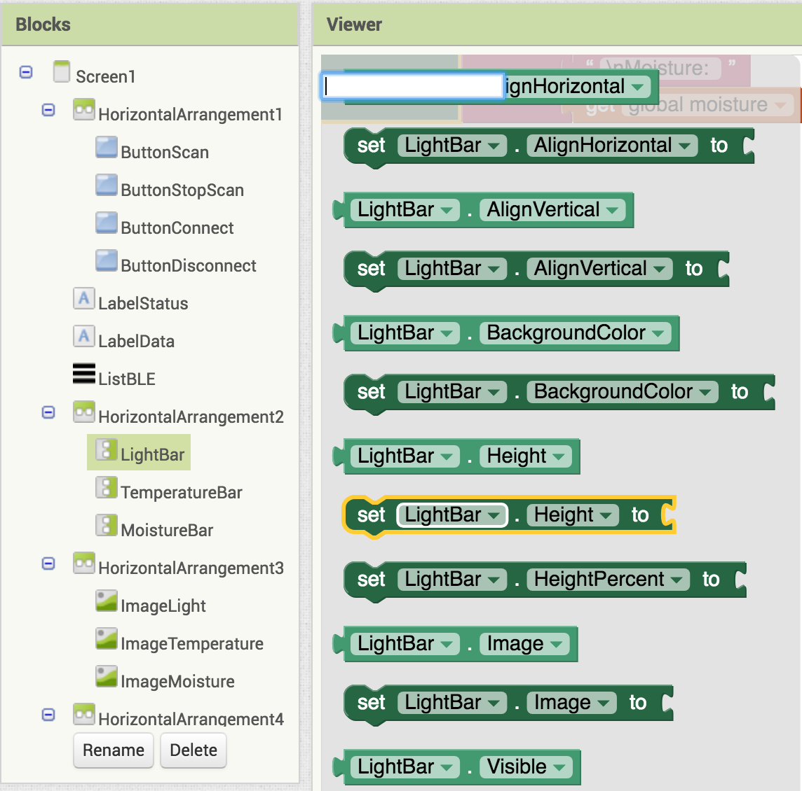


Switch to the Blocks Editor view
Now we will change the sizes of the graphs based on the readings we get
Drag in
Find
and connect them together
Add this block to the appropriate sensor updater

Slide 14
Reflection
How did your app today interact with the world? What kind of sensors did you use and what data did it collect?
What other kind of application would you like to build?
What kind of data would be collected with this new app? What kind of sensors would you need?

